Slide 1
Analysis of Sac BHC Grants from Fall 2010 through March 2016
$23,276,795 grants and contracts issued
282 grants and contracts issued to 84 orgs/contractors
31 residents living in the Sac BHC target area supported by funding
Does not include contracts to Sac Kings, Sac Republic, Americorps and most of the Healthcorps grants
Currently funding 43 entities

Slide 2
Analysis of Sac BHC Grants from Fall 2010 through Mar 2016

Slide 4
84 grantees and contractors + 282 grants and contracts = a total of $23,276,795
for the first 5 years of the Sacramento BHC

Slide 5
Examples of Hub and Coalition Facilitation and Support
Hub
Evaluation
Food Systems Collaborative
Sacramento Region Women’s Health Coalition
Facilitation of Action Teams
Sacramento Urban Ag Coalition
Legal Assistance
Capacity Building for Nonprofits
Trainings
Coalition on Regional Equity

Slide 6
School District Policies Implemented
2011: SCUSD adopts an anti-bullying policy.
2013: SCUSD adopts a policy that clarifies guidelines and protects transgender and gender variant students.
2014: SCUSD adopts positive school climate and school discipline policies to reduce suspensions and expulsions.

Slide 7
School District System and Practice Changes
2010: SCUSD establishes the Healthy Foods Task Force.
2011: SCUSD establishes the Connect Center, a centralized resource center for health and mental health services.
2012: SCUSD launches their Men's Leadership Academy (MLA-target is boys at risk of not graduating) and is now at several high and middle schools.

Slide 8
School District System and Practice Changes
2014: SCUSD establishes the Chronic Absenteeism Learning Collaborative.
2015: SCUSD establishes its 1st school based health center in the Sacramento region at Hiram Johnson High School.
2015: SCUSD creates a new position for Assistant Superintendent of Equity and Access.

Slide 9
City and County Policies Passed
2011: City Council adopts an ordinance that would allow community gardens on private vacant lots.
2013: Sacramento establishes the Neighborhood Livability Initiative to improve public and private property in unincorporated parts of the County. The County includes 3 additional code enforcement officers in their budget to staff this program.
2015: City council adopts an urban agriculture ordinance that would allow the on-site sale of produce on urban farms at home and from community gardens.

Slide 10
City and County Policies Passed
2015: City and County ordinances passed to authorize tax incentives for vacant parcels that support urban agriculture. Owners of vacant lots will be eligible for tax breaks if they use the land for agriculture for 5 years.
2015: Sacramento County Board of Supervisors dedicates 20% of former redevelopment funds (boomerang funds) toward the County’s Affordable Housing Trust Fund.
2015: Sacramento County Board of Supervisors updates County Design Guidelines, which emphasize Active Design to encourage walking and biking, and to improve access to public transit. The use of the word "health" and "healthy communities" is now embedded in the code and guidelines.

Slide 11
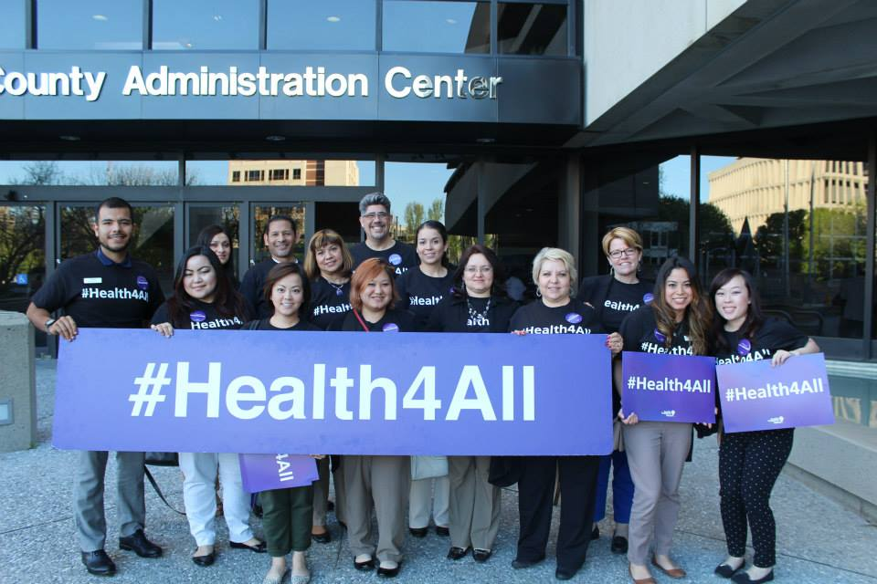
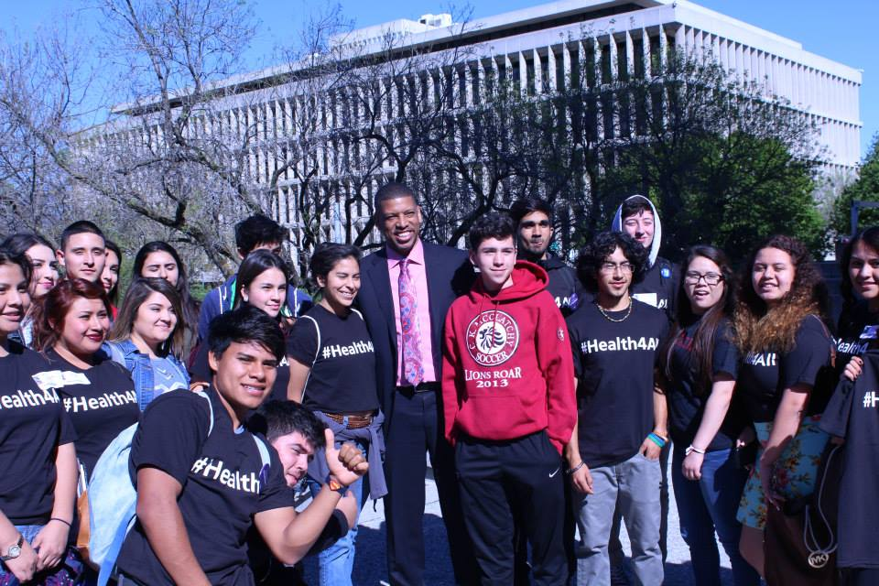
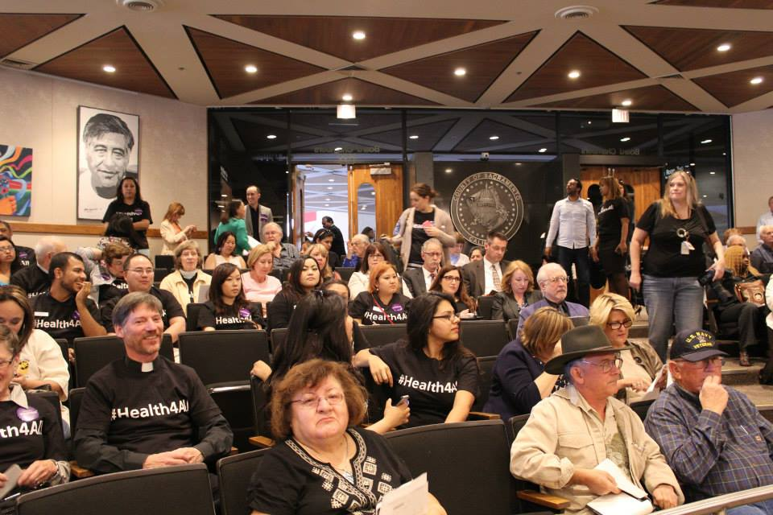
Health 4 All County Policy Passed and Being Implemented
Sacramento County Board of Supervisors approves a budget that includes funding for healthcare for the undocumented (June 16, 2015)
Sacramento County convenes a Stakeholder Group that includes BHC Hub partners to design and work through the implementation of the healthcare program for the undocumented

Slide 12
Current Policy Work in Schools
Improve school climate through the implementation of anti-bullying policies and positive school discipline and school discipline policies to reduce suspensions and expulsions.
Increase resources for low income, ELL, and foster youth through LCFF and other funding sources.
Ensure the construction of a centralized school kitchen at SCUSD.
Revise and update an existing school wellness policy at SCUSD.

Slide 13
Current Policy Work at the County
Sanction on-site sale of produce at home and from community gardens at the County.
Ensure safe and healthy homes through the adoption of a countywide rental inspection program.
Reduce incarceration and invest the savings in prevention through the implementation of Prop 47.
Identify a revenue source for the City and County’s Affordable Housing Trust Fund.
Monitor implementation of health care services for up to 3,000 undocumented at the Sacramento County Community Clinic.

Slide 14
Current Policy Work at the City
Ensure that pedestrians and bicyclists are safe through the adoption of a citywide “Vision Zero” policy.
Ensure the development of walkable and bikeable streets through the incorporation of active design principles at the city.
Identify a revenue source for the City and County’s Affordable Housing Trust Fund.
Ensure the successful establishment of a new City Department of Youth Services in 2017.

